Slide 1
Career
Technical
Education
CalWORKs Programs

Slide 2
BUILD YOUR CAREER
BUSINESS TECHNOLOGY
CONSTRUCTION TECH
CULINARY ARTS
SJCOE offers several Career Technical Education (CTE) programs to CalWORKs participants including culinary arts, construction technology, and business technology courses. All courses are held at the CalWORKs Employment Center seven hours a day for a period of 12 weeks, and consist of classroom instruction as well as on-the-job-training at various companies through business partnerships.

Slide 3
CAREER AND WORKFORCE PREPARATION
EXPERIENCED INSTRUCTORS
HANDS-ON EXPERIENCES
UP-TO-DATE TECHNOLOGY
WHAT WE OFFER
REAL-WORLD SKILLS

Slide 4
BUSINESS TECHNOLOGY

Slide 5
BUSINESS TECHNOLOGY
Critical-thinking and Decision-making
Skills
Financial Management through
Planning and Budgeting Experiences
Principles of Effective Communication
Software Technologies using
Microsoft Software Applications
Project Management through
Real-life Simulation Scenarios
Occupational Hazards and
Environmental Safety Practices

Slide 6
LEARNING OUTCOMES
Digital Technology
The student will engage in group and individual presentation simulating practical and real life situations
Professional Writing Skills
Discover your place in the modern office setting utilizing technical skills and knowledge development
Business
Communications
Employment Skills: Interview Preparation through mock interviews and portfolio development
Presentation Skills and Team Collaboration

Slide 7
INDUSTRY STATS
Entry Data Clerk
(Annual Median) $33,033
Business
Entrepreneur
Office Administration
Assistant
(Annual Median) $37,210
Office Assistant II
(Annual Median) $38,103
www.Salary.com

Slide 8
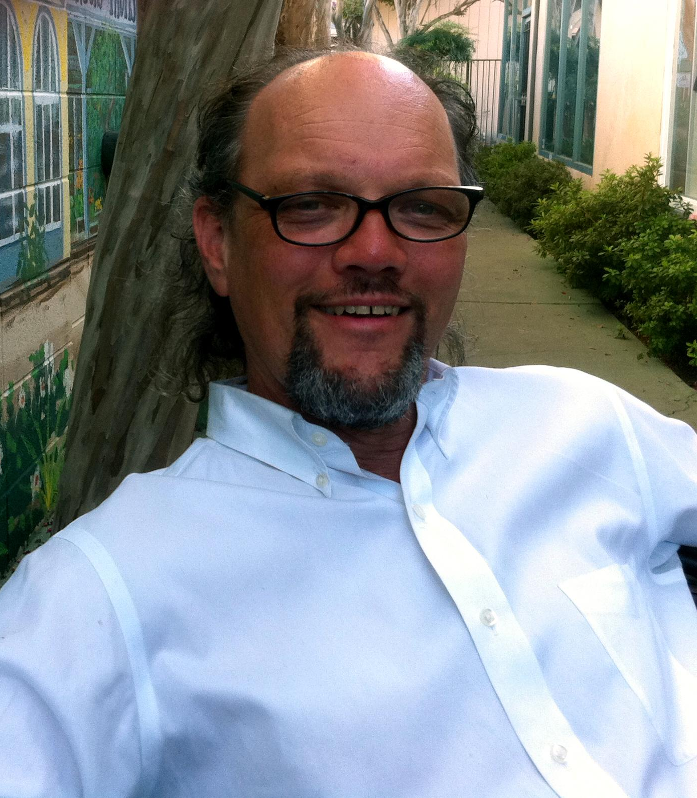
BUSINESS INSTRUCTOR
MR. HOLT
11+ Business/Software Instruction
Sole Proprietor - Software Design Industry
Sole Proprietor - Retail Industry
Academics: BA, ME

Slide 9
BUSINESS INSTRUCTOR
MS. ANDERSON
19+ Business-Software Instruction
Certified Microsoft Office Specialist
Certified Learner Management Systems - LMS
Sole Proprietor - Retail Industry
Academics: BA, MS, MBA

Slide 10
CONSTRUCTION TECHNOLOGY

Slide 11
CONSTRUCTION TECHNOLOGY
Gain certifications in NCCER Core Construction Curriculum
Gain skills in a number of construction trades allowing you to have a livable wage career instead of a meer job.
OSHA 10 Safety Certification
Experience the satisfaction and joy of looking at the end of the day at what your hands have created

Slide 12
LEARNING OUTCOMES
THE BASICS
IN ADDITION
WE COVER
WE ALSO COVER
Residential
Tools
Materials
Blueprints (plan)
Construction Math
Site Prep and Foundations
Electrical
Plumbing
Drywall
Interior Finish
Painting
Roofing
Floor, Wall and Roof Framing

Slide 13
INDUSTRY STATS
Can earn a minimum of
$15/hr (no less)
Non-union Students
Graduated to earn
$21/hr
Journeyman Experience
$25/hr (laborer) to as
much as $60/hr (electrician)

Slide 14
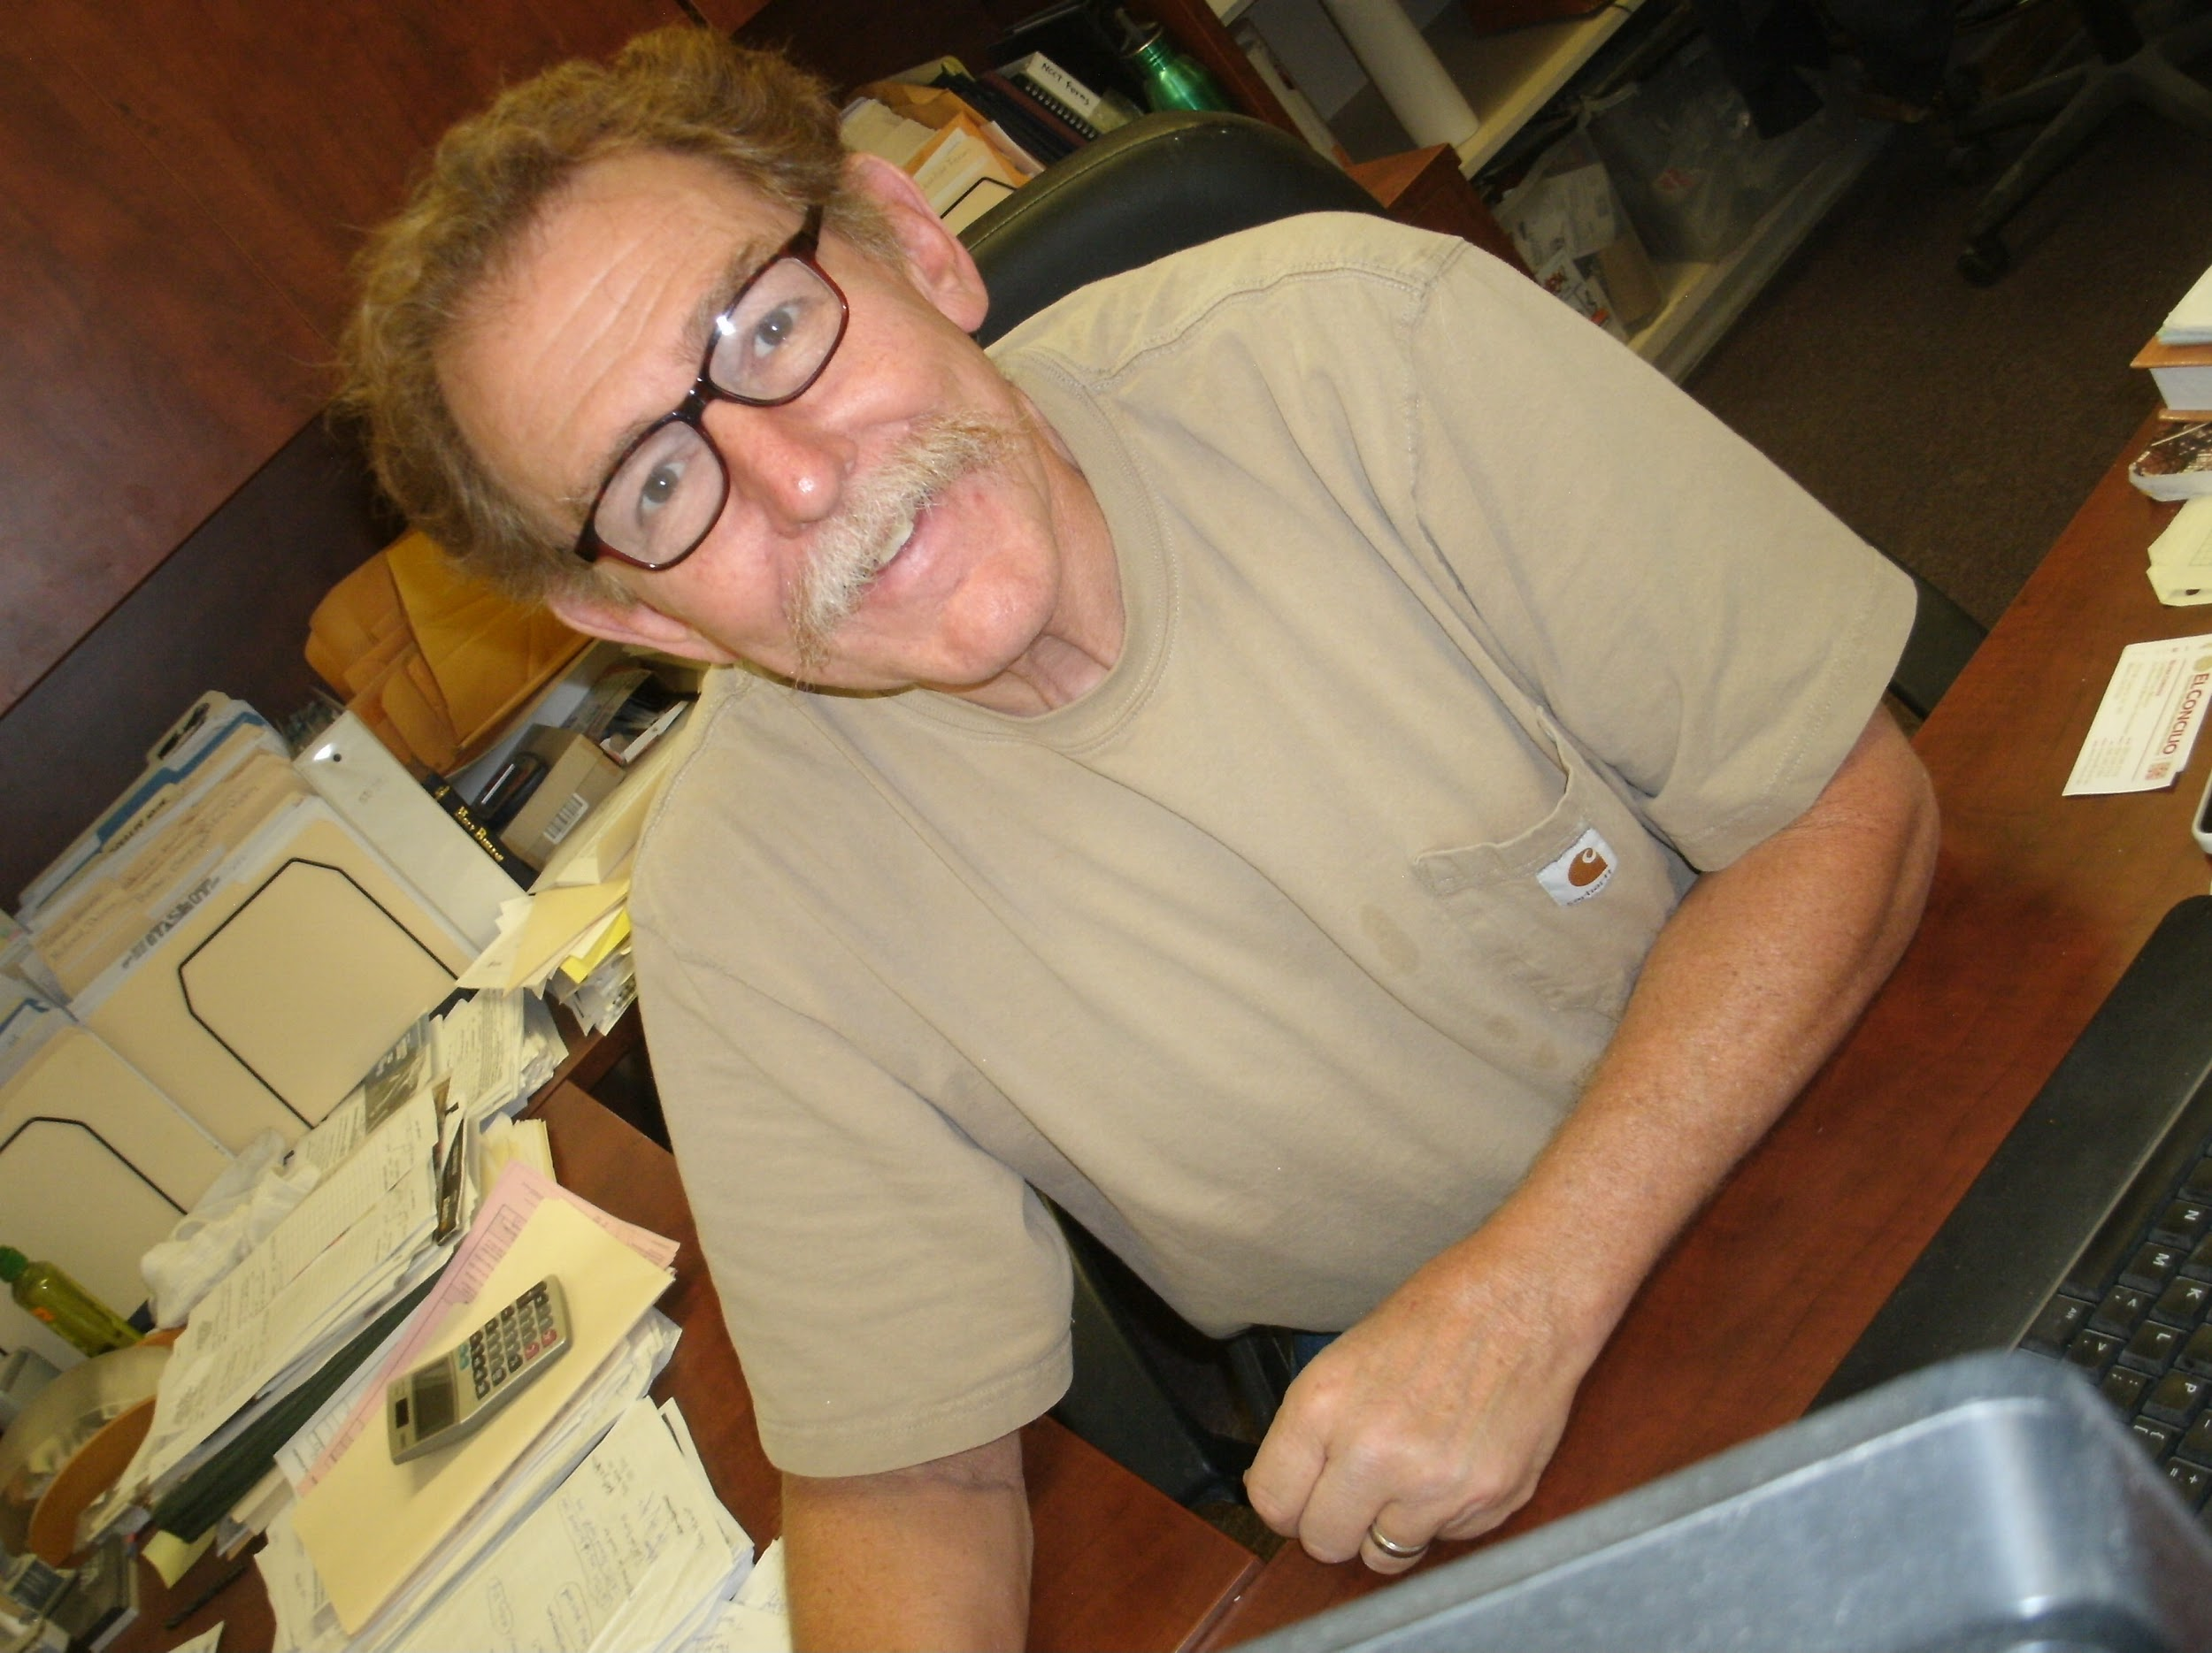
CONSTRUCTION INSTRUCTOR
MR. WOLF
15+ years Building Construction Instructor
CA State Contractors License since 1985
OSHA 10 and 30 Outreach Coordinator
Certified multiple trades instruction NCCER
Academics: BS Forestry, CTE Credential

Slide 15
CULINARY OCCUPATIONS

Slide 16
THE ART OF COOKING
?
Are you interested in food safety?
?
Are you ready to learn about entrepreneurship and hospitality?
?
Are you curious about moving forward in the food industry during COVID-19?

Slide 17
LEARNING OBJECTIVES
OBTAIN FOOD HANDLER’S CARD
HANDS-ON EXPERIENCE IN QUANTITY COOKING
SIMULATION OF BUSINESS MODELS
RESTAURANT
FOOD TRUCK
CATERING
MANAGER’S CERTIFICATION

Slide 18
INDUSTRY STATS
Food Service Manager Earnings - $28+ Hourly
Entreprenuership Earnings-Open
Line Cook
Earnings - $13-$18 Hourly
Food Service Worker Earnings - $19-$24 Hourly

Slide 19
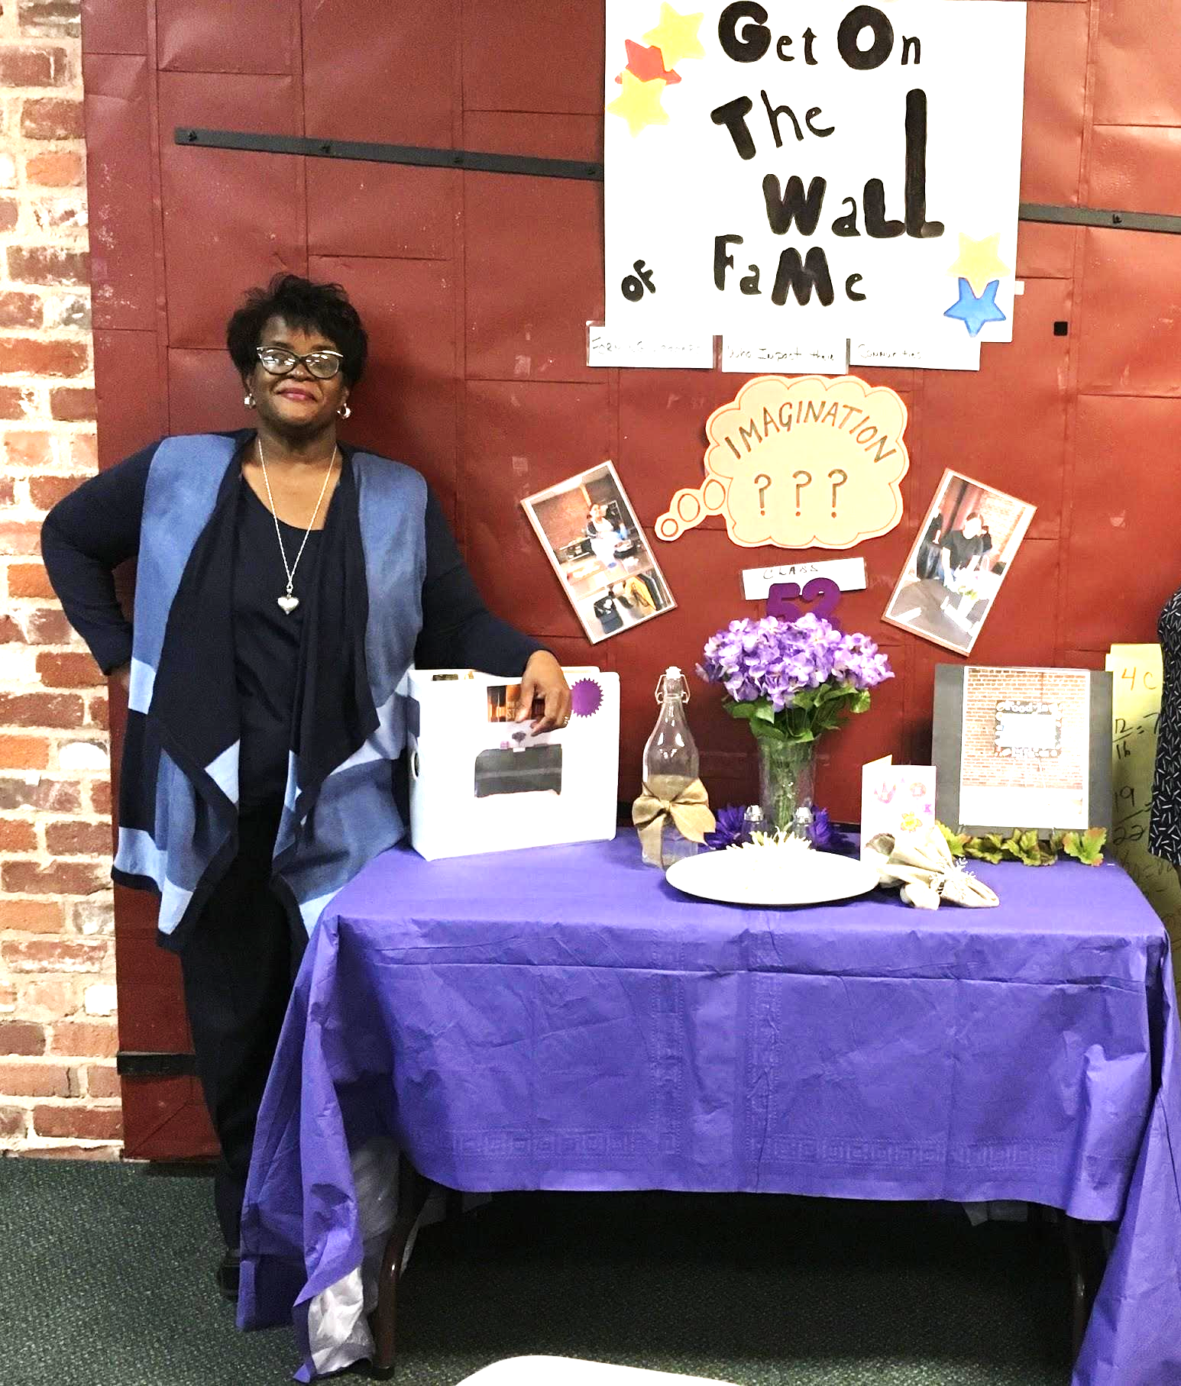
MEET MRS. JOYNER
30+ YEARS OF EXPERIENCE IN HOSPITALITY
EDUCATOR: 60+ CLASSES ADMINISTERED
INNOVATED AND DEVELOPED THE CULINARY OCCUPATIONS PROGRAM
ACADEMIC DEGREE CERTIFIED (BS, MA)
CULTIVATED INDUSTRY PARTNERSHIPS
WHOLENESS APPROACH TO SUCCESS

Slide 20
NEXT START DATES:
20-21
BUSINESS TECHNOLOGY
BUSINESS TECHNOLOGY
Monday – Friday
Session I: Aug 10-Nov 9, 2020
Session II: Nov 12-Mar 1, 2021
Session III: Mar 15-June 16, 2021
Location: CalWORKS
Monday – Friday
Session I: Aug 24-Dec 2, 2020
Session II: Dec 7-Mar 17, 2021
Session III: Mar 24-June 25, 2021
Location: CalWORKS

Slide 21
NEXT START DATES:
20-21
CONSTRUCTION OCCUPATIONS
CULINARY OCCUPATIONS
Monday – Friday
Session I: Aug 11-Nov 10, 2020
Session II: Dec 1-Mar 11, 2021
Session III: Mar 29-June 28, 2021
Location: BFA
Monday – Friday
Session I: Aug 6-Nov 5, 2020
Session II: Nov 30-Mar 10, 2021
Session III: Mar 22-June 21, 2021
Location: CalWORKS

Slide 22
TAKE YOUR NEXT STEPS

